Slide 1
The diversity of plaques in London and identifying ‘bad actors’
Analyzing the diversity of the people commemorated on the open plaque database in London and identifying ‘bad actors’

Slide 2
Contents
Why
Who + What
Where
When
How

Slide 3
Why
The recent interest in the ‘Black Liver Matter’ movement has led to the scrutiny of many public status and monuments as to whether the attributed person deserves to be kept up due to there links to the slave trade and racism.
Plaques are in the public domain and thus should also undergo the same scrutiny.
It is also of interest to see the diversity of those commemorated on the plaques to observe the extend of implicit and explicit bias’s.

Slide 4
Who, what, where
This report will look at individuals commemorated by plaques found in the London on the http://openplaques.org/ database.
The aim is to investigate the diversity of those commemorated on plaques in London and to identify those who have links to the slave trade.

Slide 5
When
This report is a side project of the openplaques open source repository.
Work on the report was done from: 11-06-2020 to 07-07-2020

Slide 6
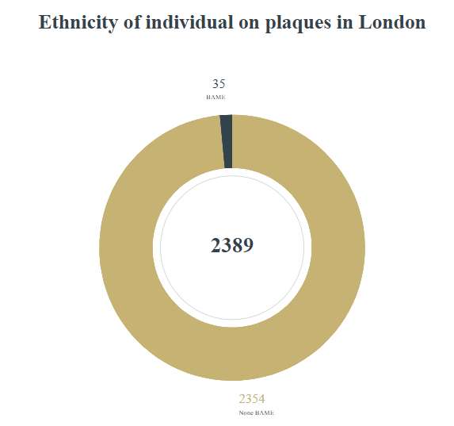
How – diversity of plaques In London
Initially I used the ethnicity field which signified BAME individual as shown in the pie chart.
To retrieve the ethnicity of whose on the plaques, I used a qwikidata api to fetch data from the wikidata database.

Slide 7
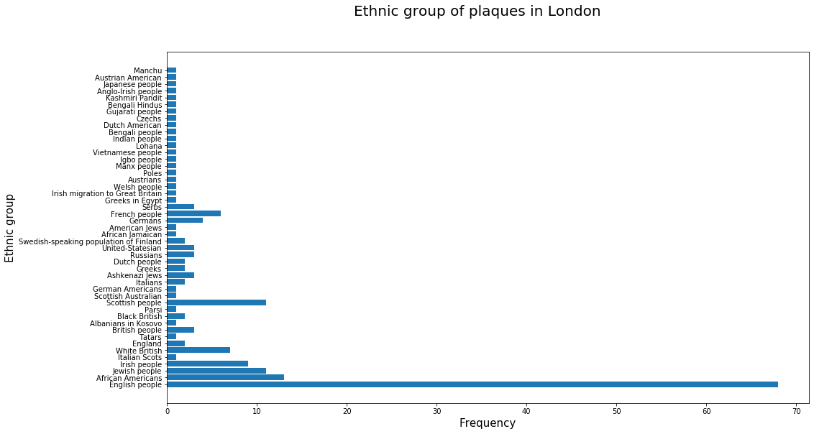
This also reinforces the lack of ethnicity between those commemorated by the plaques in London.

Slide 8
How – individual with links to the slave trade
To identify bad actors

